Slide 1
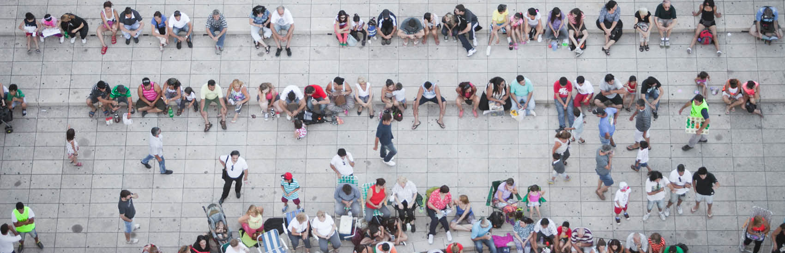
How do we make better graphs? Effective visual communication for the quantitative scientist
Mark Baillie
July 18th, 2019
Leuven, STRATOS symposia, ISCB 2019

Slide 2
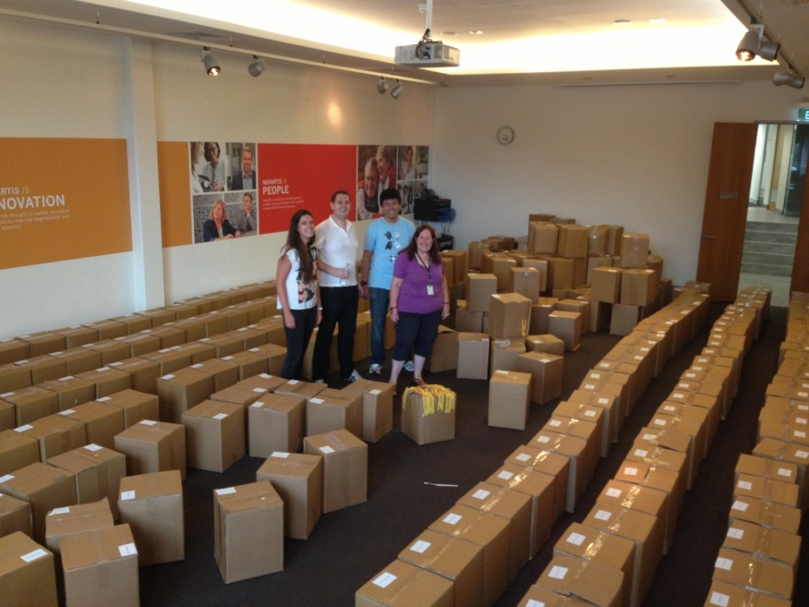

Slide 3
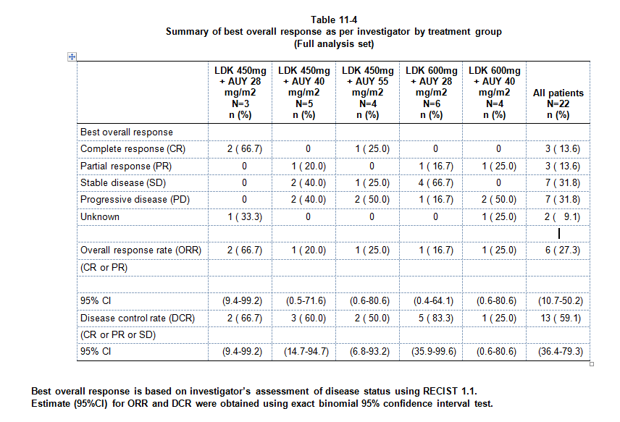

Slide 4
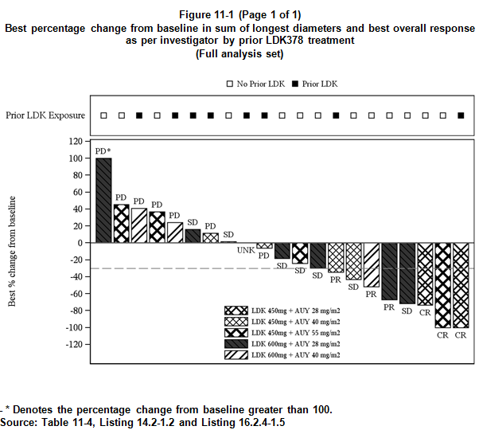

Slide 5
Elements of a grapics initiative
Graphical principles and thinking
Graphics Principles Cheat Sheet
Newsletter
Easing the implementation
Graph Gallery
Analysis Results Datasets
Standardization of most common/important graphs
Graphics tomorrow ... or today?
Question‐based visualizations and interactive graphics
... plus overarching stakeholder management and communication
https://graphicsprinciples.github.io/

Slide 6
STRATOS Visualisation panel
“Visualization and the use of graphics can help at every stage of an analysis, from the planning and design of an experiment, the very first data explorations, through to the communication of conclusions and recommendations. Visualization is more than "plotting data"; it can lead to a deeper understanding and inform next steps.
The role of the STRATOS visualization panel is to promote the use of good graphical principles for effective visual communication, providing guidance and recommendations covering all aspects from the design, implementation and review of statistical graphics.”
http://www.stratos-initiative.org

Slide 7
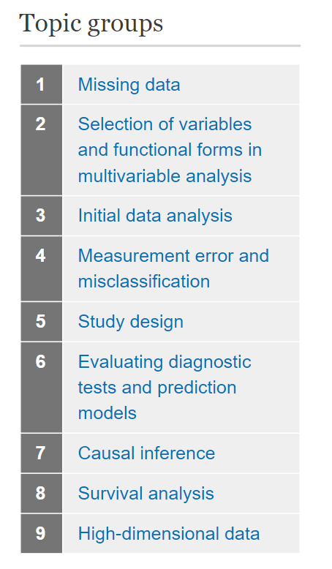
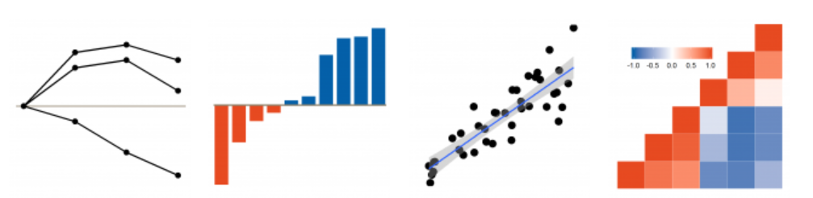
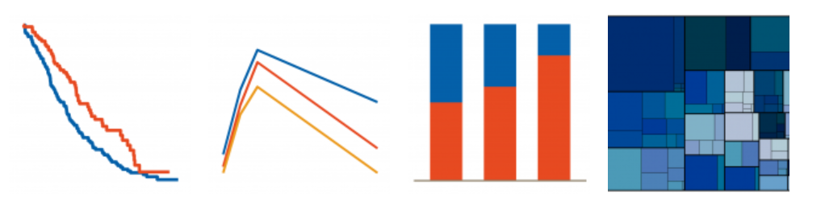
Effective visualisation is important throughout the workflow

Slide 8
“Data Display is critical to data analysis. Graphs allow us to explore data to see overall patterns and to see detailed behavior; no other approach can compete in revealing the structure of data so thoroughly.
Graphs allow us to view complex mathematical models fitted to data, and they allow us to assess the validity of such models”
William Cleveland,
The Elements of Graphing Data (1985)

Slide 9
How do we get there?
How do we tell a good graph from a bad one?
How do we ensure we design a good graph that is fit for purpose?
Recall goal: enhance understanding and use of good graphical principles

Slide 10
Effective data visualisation is effective visual communication
Effective graphs...
are visually appealing, intuitive, legible
use the correct graph type and axis scales
use proximity & alignment to facilitate comparison
use labels and annotations to add clarity to the message
Most importantly, effective use of visualisations
Enables clear and impactful communication
Elevates influence with stakeholders
Facilitates informed decision making

Slide 11
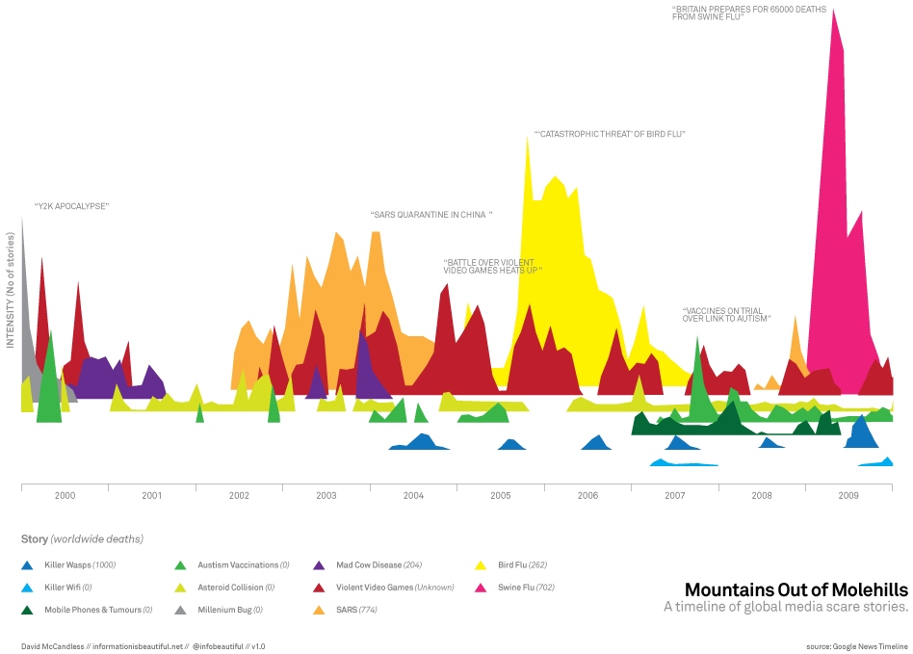
Beautiful but effective?

Slide 12
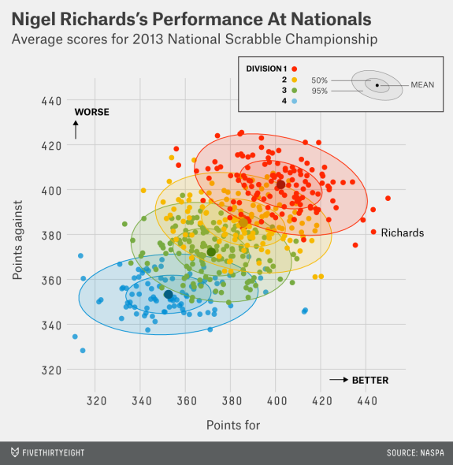
Beautiful and effective

Slide 13
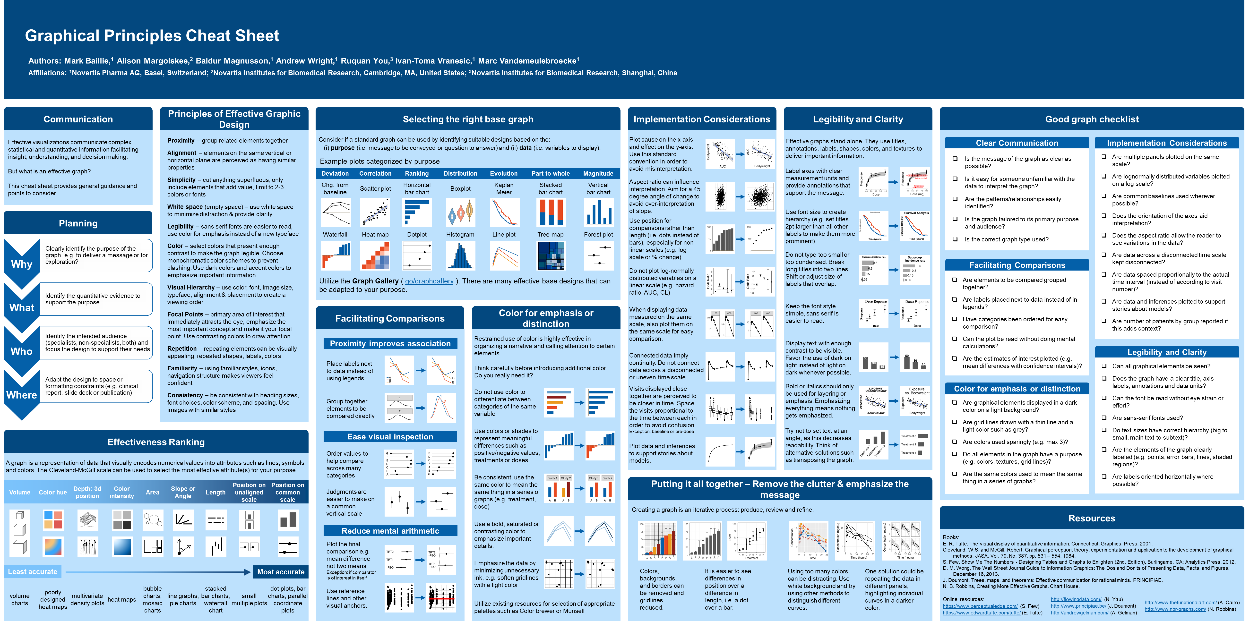
Principles for effective visual communication

Slide 14
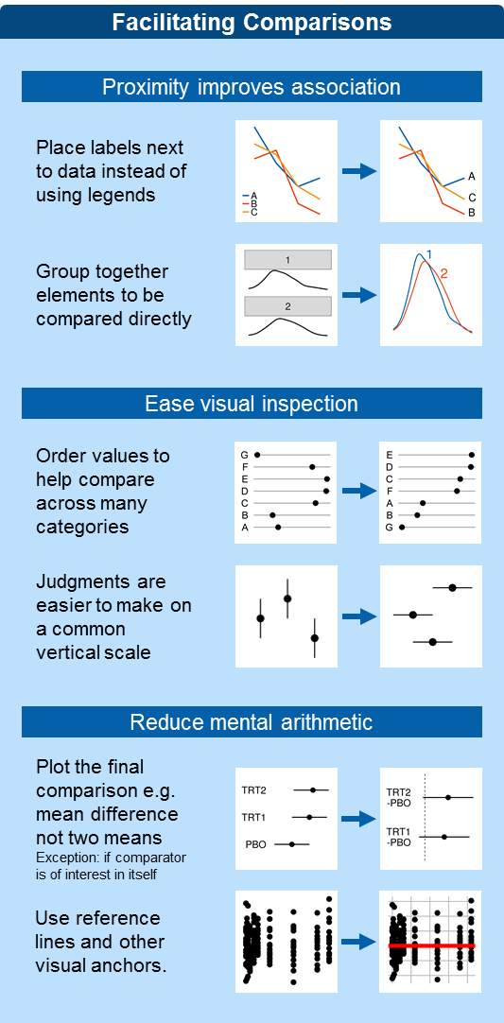
Use the cheat sheet for critical review

Slide 15
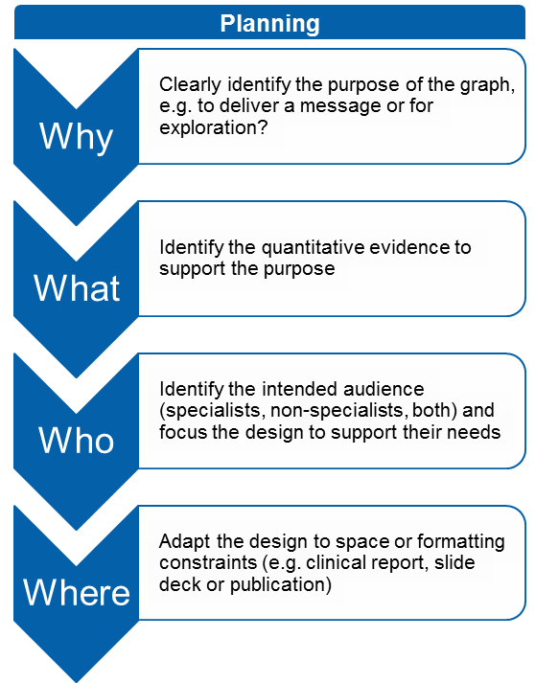
Use the cheat sheet for critical review

Slide 16
Principles for effective visual communication

Slide 17
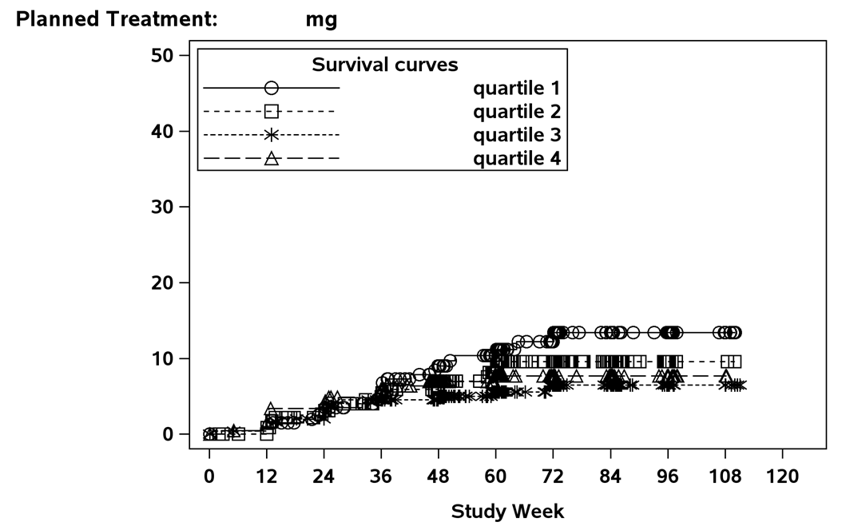
This is a continual process

Slide 18
Three laws for improving visual communication
Have a clear purpose
Know the purpose of creating the graph
Identify the quantitative evidence to support the purpose
Identify the audience and focus the design to support their needs
Show the data clearly
Choose the appropriate graph type to display your data
Avoid misrepresentation (use appropriate scales)
Maximize data to ink ratio (reduce distraction, less is more)
Make the message obvious
Use proximity and alignment to aid in comparisons
Minimize mental arithmetic (e.g. plot the difference)
Use colors and annotations to highlight important details
https://arxiv.org/abs/1903.09512

Slide 19
Elements of a STRATOS VP initiative

Slide 20
STRATOS Visualisation panel
“Visualization and the use of graphics can help at every stage of an analysis, from the planning and design of an experiment, the very first data explorations, through to the communication of conclusions and recommendations. Visualization is more than "plotting data"; it can lead to a deeper understanding and inform next steps.
The role of the STRATOS visualization panel is to promote the use of good graphical principles for effective visual communication, providing guidance and recommendations covering all aspects from the design, implementation and review of statistical graphics.”

Slide 22
Acknowledgements
Alison Margolskee
Marc Vandemeulebroecke
David Carr
Andrew Wright
Jürgen Löffler
Linda Kanitra
Baldur Magnusson
Matthew Brierley
David Ohlssen
Shaun Butcher
Julie Jones
Walter Hufford
Ruquan You
Ivan-Toma Vranesic
Ian Rees
Nicolas Guerro
Keo Chanthavinout
Frank Bretz

